Slide 1
Using Additional Node.js Modules-Using the OS Module
T. Virendra
22H51A05R9
CSE-D

Slide 2
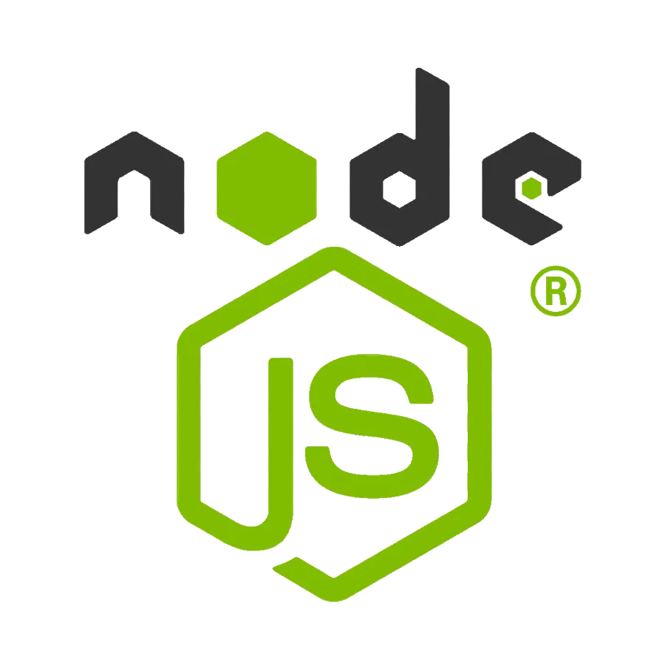
Introduction to Node.js and its Modules
Node.js is a powerful JavaScript runtime environment that allows you to execute JavaScript code outside of a web browser. It's popular for building web servers, command-line tools, and other backend applications. Node.js comes with a vast collection of modules, which are reusable pieces of code that extend the functionality of your application.

Slide 3
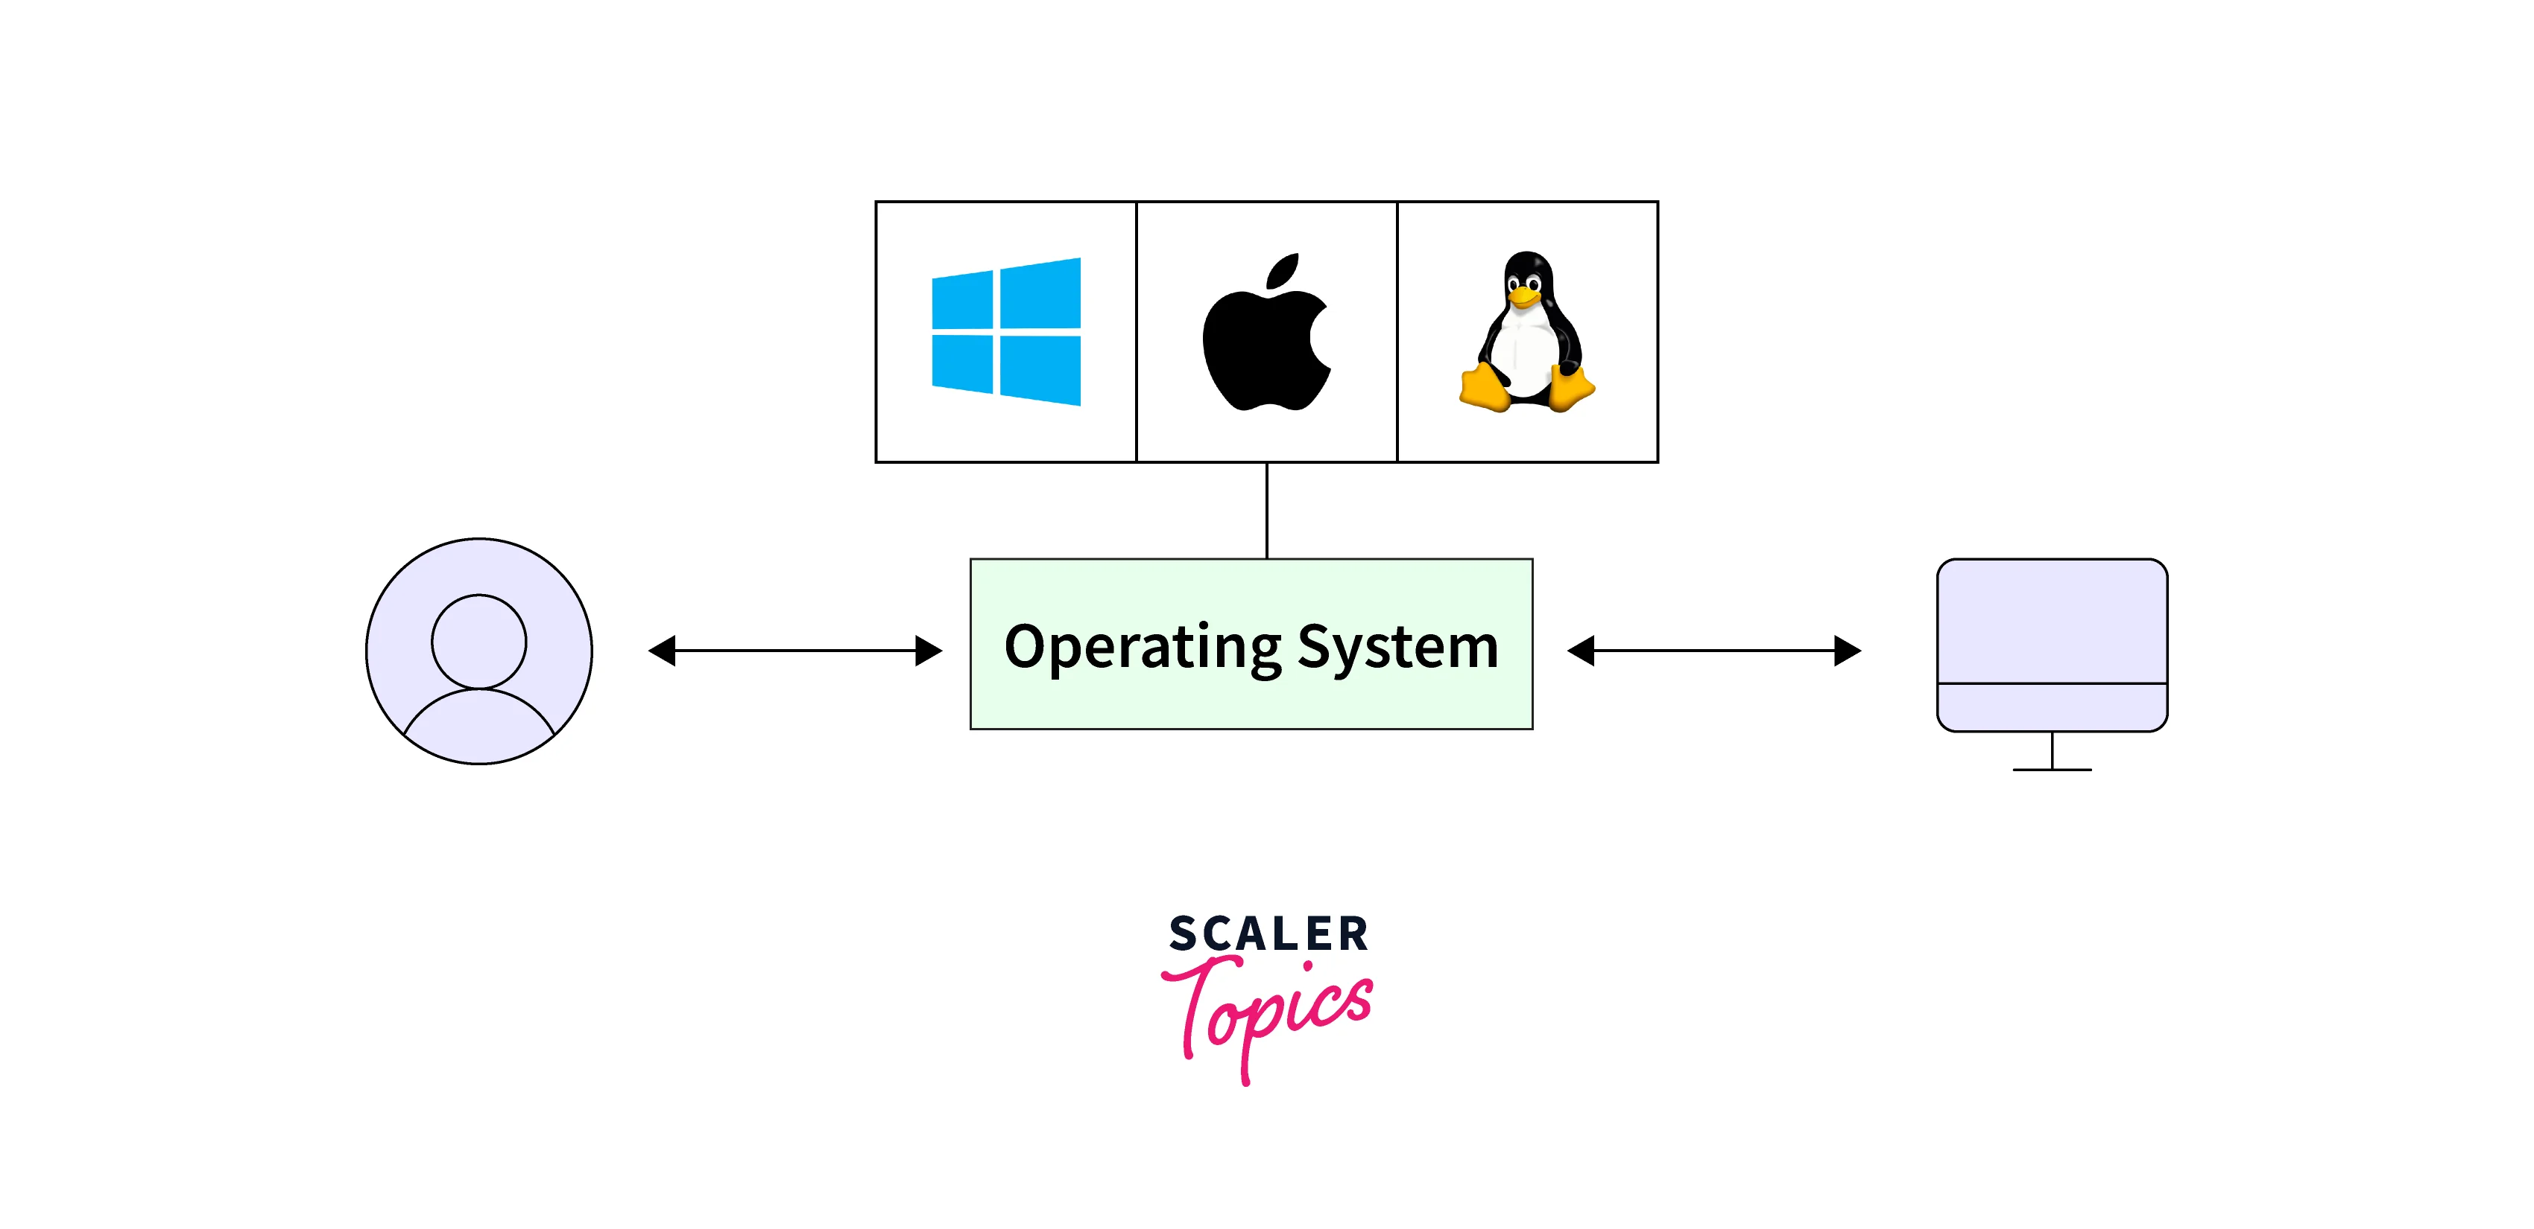
Introduction to the os Module
The `os` module provides access to operating system-specific information and functions, making it ideal for building platform-independent applications. It offers methods for retrieving hardware information, user environment details, and system performance metrics.
Hardware
User Environment
Retrieve CPU architecture, core count, free memory, and other hardware specifications.
Access information about the current user, home directory, and environment variables.
System Performance
Obtain metrics like uptime, load averages, and CPU usage.

Slide 4
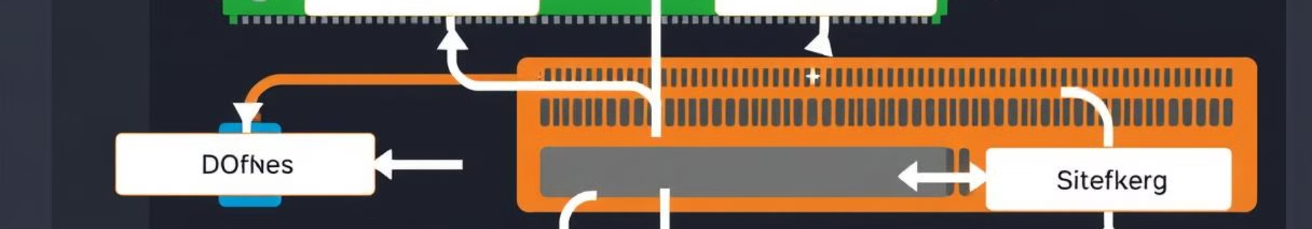
Accessing System Information
The `os` module allows you to retrieve vital information about the system it's running on, such as the operating system version, architecture, and hostname. This can be useful for logging, configuration, or tailoring your application based on the environment.
Method
Description
`os.platform()`
Returns the operating system platform, e.g., 'win32', 'darwin', 'linux'.
`os.release()`
Provides the operating system release version, e.g., '10.15.7', 'Ubuntu 20.04'.
`os.hostname()`
Gets the hostname of the system.

Slide 5
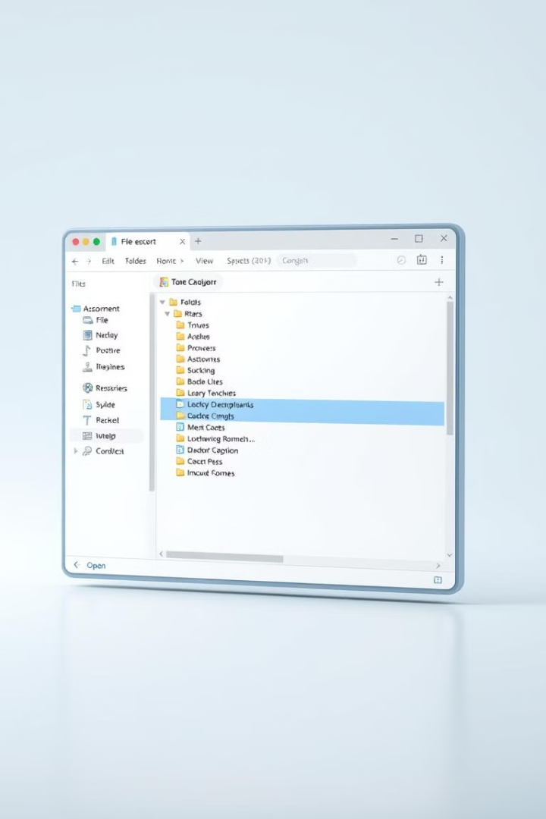
Working with File Paths
The `path` module is fundamental for handling file and directory paths in a consistent way, regardless of the operating system. It offers functions for joining, resolving, and parsing paths, simplifying the process of working with files and directories.
1
Path Manipulation
2
Directory Operations
Join path segments, normalize paths, and extract file names and extensions.
Resolve paths relative to a specific directory and create directory structures.
3
File Handling
Extract file names and extensions, and determine if a path refers to a file or a directory.

Slide 6
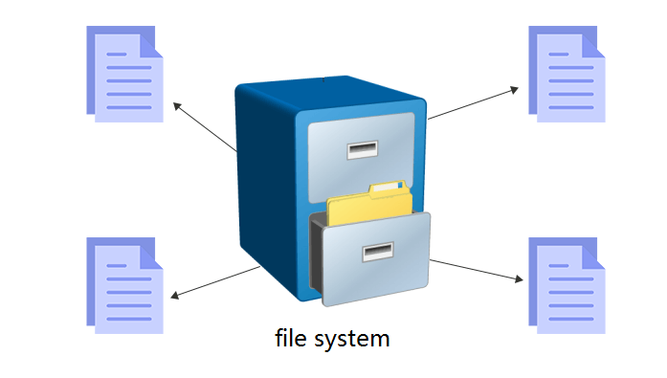



Interacting with the File System
The `fs` module gives you direct access to the file system, allowing you to read, write, and manipulate files and directories. It provides methods for creating, deleting, renaming, and checking the existence of files and directories.
Read Files
Access file contents, line by line or as a whole.
Write Files
Create new files or append data to existing files.
Directory Management
Create, delete, and list directories.

Slide 7
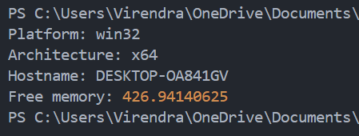
Sample Code
This code snippet demonstrates how to use the `os` module to retrieve system information:
const os = require('os');
console.log('Platform:', os.platform());
console.log('Architecture:', os.arch());
console.log('Hostname:', os.hostname());
console.log('Free memory:', os.freemem() / (1024 * 1024)); // In MB
Output

Slide 8

Conclusion
The `os` module is a powerful tool for building Node.js applications that need to interact with the underlying operating system. Understanding how to use it effectively can enhance your application's capabilities, allowing you to tailor it to specific environments and systems.
Utilizing its methods can enhance the functionality and performance of your applications.
Understanding how to leverage the OS module will help you build more efficient and robust Node.js applications.

Slide 9
Thank You!

